Slide 1
Module 17: Recovery System

Slide 2
Module 17: Recovery System
Failure Classification
Storage Structure
Recovery and Atomicity
Log-Based Recovery
Remote Backup Systems

Slide 3
Failure Classification
Transaction failure :
  Logical errors: transaction cannot complete due to some internal error condition
  System errors: the database system must terminate an active transaction due to an error condition (e.g., deadlock)
System crash: a power failure or other hardware or software failure causes the system to crash.
  Fail-stop assumption: non-volatile storage contents are assumed to not be corrupted by system crash
    Database systems have numerous integrity checks to prevent corruption of disk data
Disk failure: a head crash or similar disk failure destroys all or part of disk storage
  Destruction is assumed to be detectable: disk drives use checksums to detect failures

Slide 4
Recovery Algorithms
Consider transaction T_{i} that transfers $50 from account A to account B
  Two updates: subtract 50 from A and add 50 to B
Transaction T_{i} requires updates to A and B to be output to the database.
  A failure may occur after one of these modifications have been made but before both of them are made.
  Modifying the database without ensuring that the transaction will commit may leave the database in an inconsistent state
  Not modifying the database may result in lost updates if failure occurs just after transaction commits
Recovery algorithms have two parts
  Actions taken during normal transaction processing to ensure enough information exists to recover from failures
  Actions taken after a failure to recover the database contents to a state that ensures atomicity, consistency and durability

Slide 5
Storage Structure
Volatile storage:
  Does not survive system crashes
  Examples: main memory, cache memory
Nonvolatile storage:
  Survives system crashes
  Examples: disk, tape, flash memory, non-volatile RAM
  But may still fail, losing data
Stable storage:
  A mythical form of storage that survives all failures
  Approximated by maintaining multiple copies on distinct nonvolatile media
  See book for more details on how to implement stable storage

Slide 6
Stable-Storage Implementation
Maintain multiple copies of each block on separate disks
  copies can be at remote sites to protect against disasters such as fire or flooding.
Failure during data transfer can still result in inconsistent copies: Block transfer can result in
  Successful completion
  Partial failure: destination block has incorrect information
  Total failure: destination block was never updated
Protecting storage media from failure during data transfer (one solution):
  Execute output operation as follows (assuming two copies of each block):
    Write the information onto the first physical block.
    When the first write successfully completes, write the same information onto the second physical block.
    The output is completed only after the second write successfully completes.

Slide 7
Protecting storage media from failure (Cont.)
Copies of a block may differ due to failure during output operation.
To recover from failure:
  First find inconsistent blocks:
    Expensive solution: Compare the two copies of every disk block.
    Better solution:
      Record in-progress disk writes on non-volatile storage (Non-volatile RAM or special area of disk).
      Use this information during recovery to find blocks that may be inconsistent, and only compare copies of these.
      Used in hardware RAID systems
  If either copy of an inconsistent block is detected to have an error (bad checksum), overwrite it by the other copy. If both have no error, but are different, overwrite the second block by the first block.

Slide 8
Data Access
Physical blocks are those blocks residing on the disk.
Buffer blocks are the blocks residing temporarily in main memory.
Block movements between disk and main memory are initiated through the following two operations:
  input (B) transfers the physical block B to main memory.
  output (B) transfers the buffer block B to the disk, and replaces the appropriate physical block there.
We assume, for simplicity, that each data item fits in, and is stored inside, a single block.

Slide 9
Data Access (Cont.)
Each transaction T_{i} has its private work-area in which local copies of all data items accessed and updated by it are kept.
  T_{i} 's local copy of a data item X is called x_{i}.
Transferring data items between system buffer blocks and its private work-area done by:
  read(X) assigns the value of data item X to the local variable x_{i}.
  write(X) assigns the value of local variable x_{i} to data item {X} in the buffer block.
  Note: output(B_{X}) need not immediately follow write(X). System can perform the output operation when it deems fit.
Transactions
  Must perform read(X) before accessing X for the first time (subsequent reads can be from local copy)
  write(X) can be executed at any time before the transaction commits

Slide 10
Example of Data Access
buffer
Buffer Block A
input(A)
X
A
Buffer Block B
Y
B
output(B)
read(X)
write(Y)
x₂
x₁
y₁
work area
of T₁
work area
of T₂
memory
disk

Slide 11
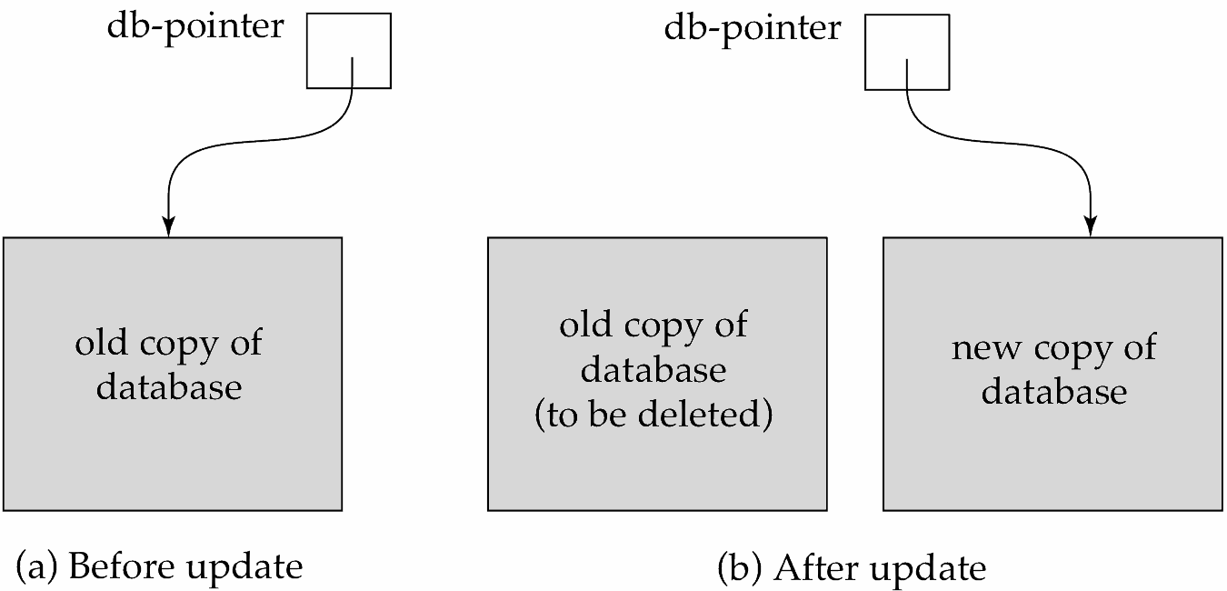
Recovery and Atomicity
To ensure atomicity despite failures, we first output information describing the modifications to stable storage without modifying the database itself.
We study log-based recovery mechanisms in detail
  We first present key concepts
  And then present the actual recovery algorithm
Less used alternative: shadow-copy and shadow-paging (brief details in book)
shadow-copy

Slide 12
Log-Based Recovery
A log is a sequence of log records. The records keep information about update activities on the database.
  The log is kept on stable storage
When transaction T_{i} starts, it registers itself by writing a
<T_{i} start>log record
Before T_{i} executes write(X), a log record
<T_{i}, X, V₁, V₂>
is written, where V₁ is the value of X before the write (the old value), and V₂ is the value to be written to X (the new value).
When T_{i} finishes it last statement, the log record <T_{i} commit> is written.
Two approaches using logs
  Immediate database modification
  Deferred database modification.

Slide 13
Immediate Database Modification
The immediate-modification scheme allows updates of an uncommitted transaction to be made to the buffer, or the disk itself, before the transaction commits
Update log record must be written before database item is written
  We assume that the log record is output directly to stable storage
  (Will see later that how to postpone log record output to some extent)
Output of updated blocks to disk can take place at any time before or after transaction commit
Order in which blocks are output can be different from the order in which they are written.
The deferred-modification scheme performs updates to buffer/disk only at the time of transaction commit
  Simplifies some aspects of recovery
  But has overhead of storing local copy

Slide 14
Transaction Commit
A transaction is said to have committed when its commit log record is output to stable storage
  All previous log records of the transaction must have been output already
Writes performed by a transaction may still be in the buffer when the transaction commits, and may be output later

Slide 15
Immediate Database Modification Example
Log Write Output
<T₀ start>
<T₀, A, 1000, 950>
<T_{o}, B, 2000, 2050>
A = 950
B = 2050
<T₀ commit>
<T₁ start>
<T₁, C, 700, 600>
C = 600
B_{B} , B_{C}
<T₁ commit>
B_{A}
Note: B_{X} denotes block containing X.
B_{C} output before T₁ commits
B_{A} output after T₀ commits

Slide 16
Concurrency Control and Recovery
With concurrent transactions, all transactions share a single disk buffer and a single log
  A buffer block can have data items updated by one or more transactions
We assume that if a transaction T_{i} has modified an item, no other transaction can modify the same item until T_{i} has committed or aborted
  i.e., the updates of uncommitted transactions should not be visible to other transactions
    Otherwise, how to perform undo if T₁ updates A, then T₂ updates A and commits, and finally T₁ has to abort?
  Can be ensured by obtaining exclusive locks on updated items and holding the locks till end of transaction (strict two-phase locking)
Log records of different transactions may be interspersed in the log.

Slide 17
Undo and Redo Operations
Undo and Redo of Transactions
  undo(T_{i}) -- restores the value of all data items updated by T_{i} to their old values, going backwards from the last log record for T_{i}
    Each time a data item X is restored to its old value V a special log record <T_{i} , X, V> is written out
    When undo of a transaction is complete, a log record
    <T_{i} abort> is written out.
  redo(T_{i}) -- sets the value of all data items updated by T_{i} to the new values, going forward from the first log record for T_{i}
    No logging is done in this case

Slide 18
Recovering from Failure
When recovering after failure:
  Transaction T_{i} needs to be undone if the log
    Contains the record <T_{i} start>,
    But does not contain either the record <T_{i} commit> or <T_{i} abort>.
  Transaction T_{i} needs to be redone if the log
    Contains the records <T_{i} start>
    And contains the record <T_{i} commit> or <T_{i} abort>

Slide 19
Recovering from Failure (Cont.)
Suppose that transaction T_{i} was undone earlier and the <T_{i} abort> record was written to the log, and then a failure occurs,
On recovery from failure transaction T_{i} is redone
  Such a redo redoes all the original actions of transaction T_{i} including the steps that restored old values
    Known as repeating history
    Seems wasteful, but simplifies recovery greatly

Slide 20

Immediate DB Modification Recovery Example
Below we show the log as it appears at three instances of time.
Recovery actions in each case above are:
(a) undo (T₀): B is restored to 2000 and A to 1000, and log records
<T₀, B, 2000>, <T₀, A, 1000>, <T₀, abort> are written out
(b) redo (T₀) and undo (T₁): A and B are set to 950 and 2050 and C is restored to 700. Log records <T₁, C, 700>, <T₁, abort> are written out.
(c) redo (T₀) and redo (T₁): A and B are set to 950 and 2050
respectively. Then C is set to 600

Slide 21
Checkpoints
Redoing/undoing all transactions recorded in the log can be very slow
  Processing the entire log is time-consuming if the system has run for a long time
  We might unnecessarily redo transactions which have already output their updates to the database.
Streamline recovery procedure by periodically performing checkpointing
  Output all log records currently residing in main memory onto stable storage.
  Output all modified buffer blocks to the disk.
  Write a log record < checkpoint L> onto stable storage where L is a list of all transactions active at the time of checkpoint.
  All updates are stopped while doing checkpointing

Slide 22
Checkpoints (Cont.)
During recovery we need to consider only the most recent transaction T_{i} that started before the checkpoint, and transactions that started after T_{i}.
  Scan backwards from end of log to find the most recent <checkpoint L> record
  Only transactions that are in L or started after the checkpoint need to be redone or undone
  Transactions that committed or aborted before the checkpoint already have all their updates output to stable storage.
Some earlier part of the log may be needed for undo operations
  Continue scanning backwards till a record <T_{i} start> is found for every transaction T_{i} in L.
  Parts of log prior to earliest <T_{i} start> record above are not needed for recovery, and can be erased whenever desired.

Slide 23
Example of Checkpoints
T_{c}
T_{f}
T₁ can be ignored (updates already output to disk due to checkpoint)
T₂ and T₃ redone.
T₄ undone
T₁
T₂
T₃
T₄
checkpoint
system failure

Slide 24
End of Module 17

